Slide 1

CookEase
By: Yueying Ke, Pallavi Mekala, Fnu Mibu Kurian Sam, Varunika Ramadugu, Jacian Wynn
CS/SE 3354.003

Slide 2
Problem
Solution
Many people struggle to decide what to cook, mismanage food waste, and stress about cooking due to leftover ingredients, varying meal preferences, and dietary restrictions.
Introducing CookEase!
A web application that personalizes recipes based on the ingredients available in the user's pantry.

Slide 3
Objectives/Motivations!
HEALTH
TIME
WASTE
Promote healthy eating with nutritious recipes
Save time with personalized recipes based on available ingredients
Reduce food waste by utilizing ingredients
available to create custom recipes
STRESS
SOCIALIZE
TASTE
Minimize stress with an easy-to-use app for meal planning and cooking
Foster social connections through sharing recipes and connect with friends
Enhance the enjoyment of meals by providing delicious and custom recipes

Slide 4



Features
Personalized Recipe Generator
Ingredient Categorization (categorize ingredients
into different groups)
Filter Options (by different cuisines, meal of the day, sweet/savory, and dietary preferences)
Nutritional Information
Recipe articles:
Comment function
(share feedback, tips, suggestions)
Video and written instructions
Serving size and cooking time
Save/Share recipes
Post recipes
Connect with friends
Dark/Light mode
Translator option
Read-aloud option
Tip recipe owners
via buymeacoffee.com [1]
Fig 1. [1]

Slide 5
Functional Requirements
Personalization of recipes based on pantry ingredients or meal preference
Creation of an app or website to access the recipes
Categorization of ingredients by fruits, vegetables, meats, dairy, etc.
Input of available ingredients by user and generation of customized recipe
Provision of nutritional info, serving size, and cooking time for each recipe
Posting of user-generated recipes
Selection of recipes through filters
Availability of alternative ingredients for substitution
Inclusion of a comment function for each recipe
Provision of both video and written instructions for each recipe
Ability to connect with friends

Slide 6

Non-Functional Requirements
Usability requirements
Performance requirements
Space requirements
Dependability requirements
Security requirements
Environmental requirements
Operational requirements
Development requirements
Regulatory requirements
Ethical requirements
Accounting requirements
Safety/security requirements

Slide 7
Cost Estimations
Software Products
Hardware Products
Cost, effort, pricing estimation
Personnel

Slide 8
Estimation Cost of Software Products
Front-End
Back-End
HTML, CSS, JavaScript [2]
Node.js, Ruby on Rails, Django [3]
Database Management
API Integration
MySQL [4]
RESTful APIs & GraphQL [5], [6]
Search engine
Video/Streaming Service
Elasticsearch [7]
YouTube [8]
Social Media Integration
Management & Publishing
Facebook & Twitter APIs [9], [10]
Cookpad & TastyIgniter [11], [12]
Analytics Tools
Crowdfunding
Google Analytics & Mixpanel
[13], [14]
Buy Me a Coffee [15]
Total Cost Estimation = $0

Slide 9
Estimation Cost of Hardware Products
$108
$3,119.13
$50/month
Memory
PC/Processing Unit
Network
Server Memory - Random Access Memory (RAM)
16 GB [16]
5 HP Laptops = 5 x $330 = $1,650 [17]
CPU: Intel Core i5 = $319.13 [18]
Storage: HDD: 50TB Amazon S3 Simple Storage = $0.023/GB x 50,000 GB = $1,150/month [5]
T-Mobile [19]
Total Cost Estimation = $108 + $3,119.13 + $50 = $3,277.13

Slide 10
Cost, Effort, Pricing Estimation – Function Point
 | Functional Category | Count | Complexity |  |  | Count x Complexity
 |  |  | Simple | Average | Complex
1 | User input | 10 | 3 | 4 | 6 | 40
2 | User output | 1 | 4 | 5 | 7 | 5
3 | User Queries | 4 | 3 | 4 | 6 | 16
4 | Data files and Relational Tables | 5 | 7 | 10 | 15 | 50
5 | External Interfaces | 6 | 5 | 7 | 10 | 42
 |  |  | GFP |  |  | 153
GFP = 153 FP
Processing Complexity (PC) = 2 + 2 + 1 + 5 + 4 + 5 + 1 + 4 + 3 + 3 + 4 + 0 + 0 + 5 = 39
PCA = 0.65 + 0.01 (2 + 2 + 1 + 5 + 4 + 5 + 1 + 4 + 3 + 3 + 4 + 0 + 0 + 5) = 1.04
FP = GFP x PCA = 153 x 1.04 = 159.12 FP
Productivity of development and maintenance teams = 30
E = FP / productivity = 159.12 / 30 ≈ 5.304 ≈ 6 person-weeks
Team size = 4 developers
Project Duration = D = E / team size = 6 / 4 = 1.5 ≈ 2 weeks

Slide 11
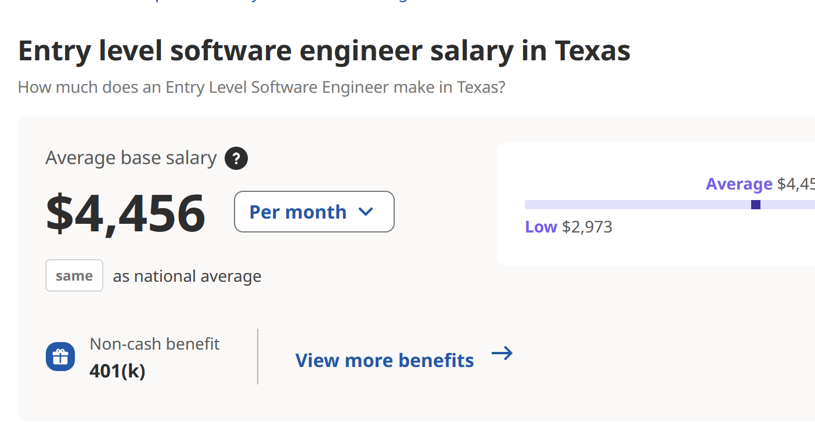
Estimation Cost of Personnel
According to our previous effort estimates,
Effort (person/month) = 159.12 / 30
Effort (person/month) = 5.3 person-months
There are 5 members of in the team, so the total effort is:
Total effort (in person/month) = 5.3 x 5 = 26.5 person/month
Fig. 2 [20]
Total Cost = Total effort (in person-months) x Cost per person/month = 26.5 x $4,456 =$118,084 [20]
Notes:
[8]
[9]
[10]
[11]
[12]

Slide 12
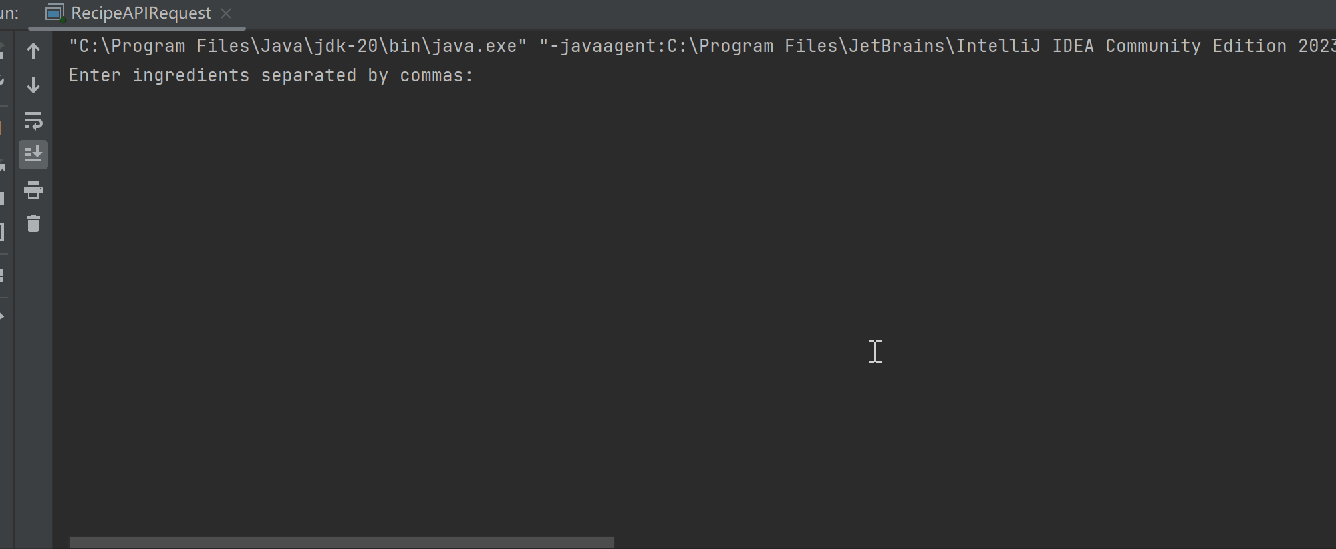
Testing
Class runs and uses “GET” method to request calls from the Edamam API [21], then receives responses from API and returns a list of recipes.
Notes:
[8]
[9]
[10]
[11]
[12]

Slide 13
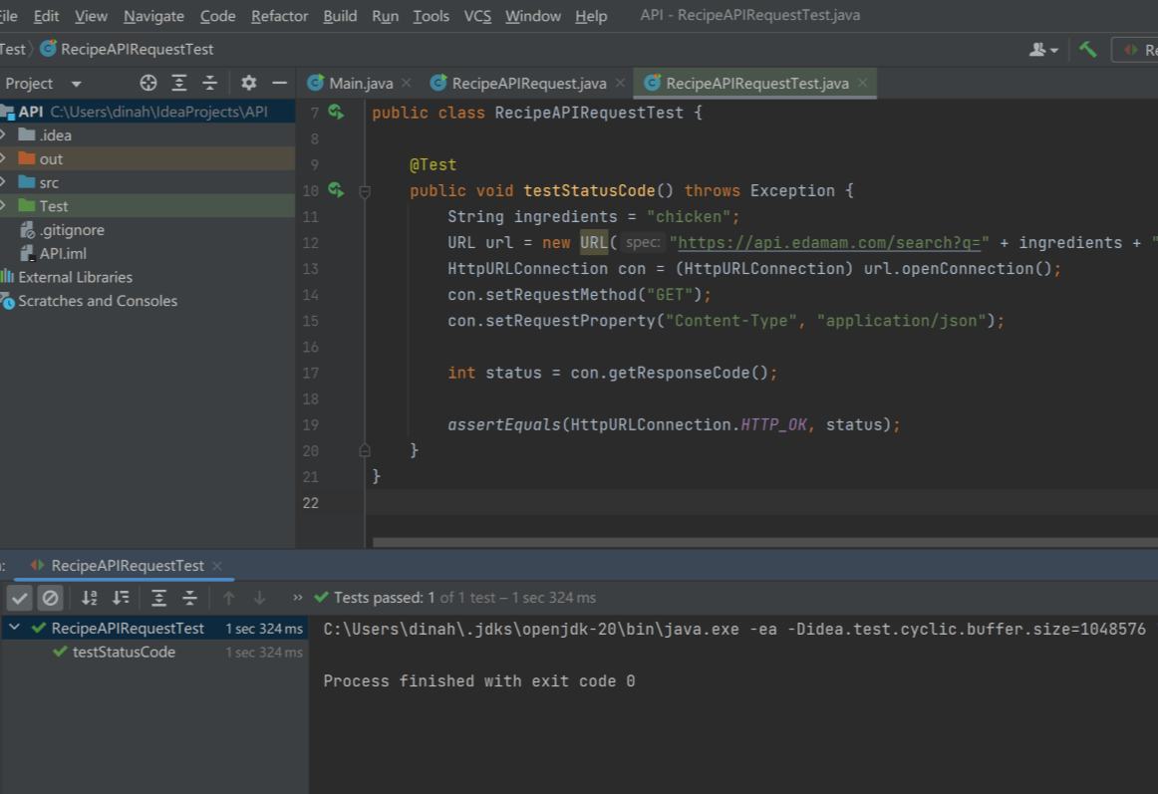
Testing
Test shows successful “GET” request call from the Edamam API [21].
Notes:
[8]
[9]
[10]
[11]
[12]

Slide 14
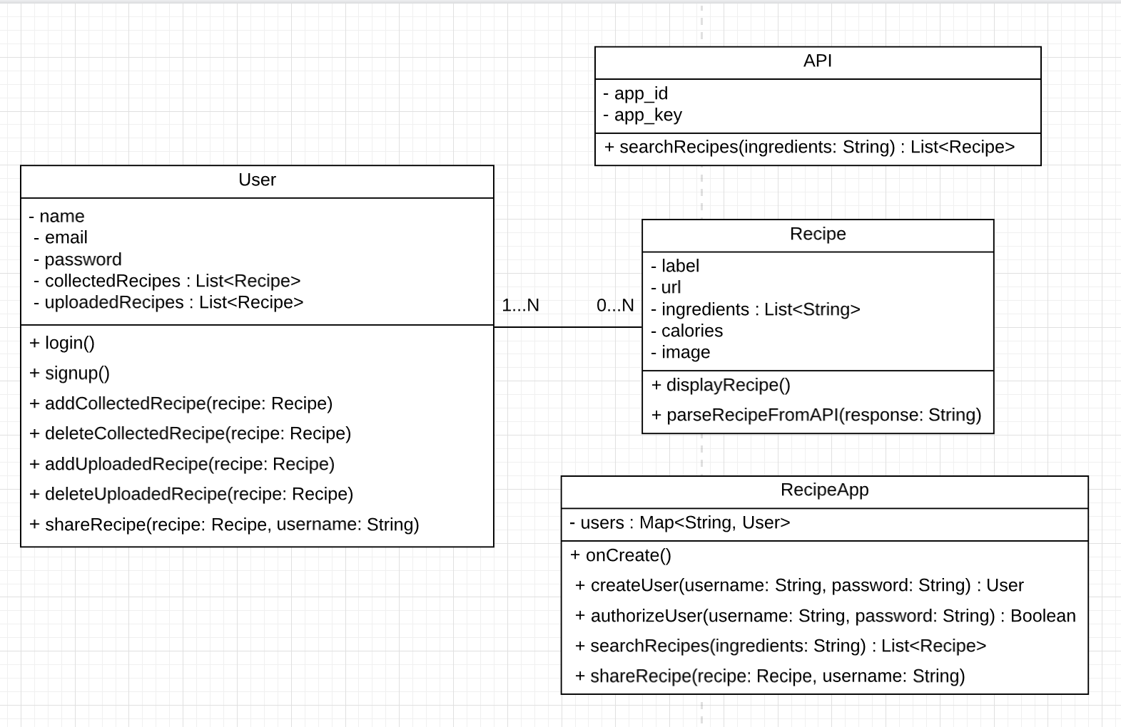
Class Diagram
Notes:
[8]
[9]
[10]
[11]
[12]

Slide 15
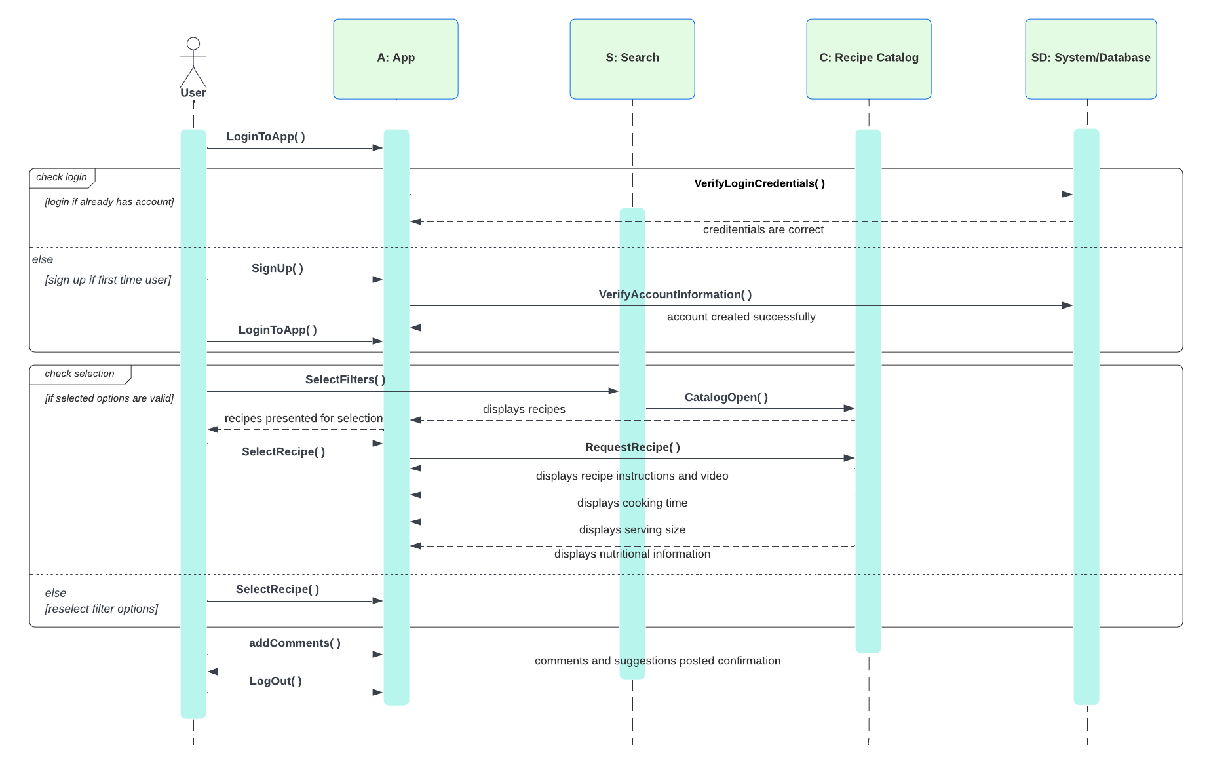
Sequence Diagram - generating recipes

Slide 16
Architectural Design Model-View-Controller (MVC) pattern
MODEL
VIEW
CONTROLLER
Represents data and business logic:
Database of recipes: nutritional information, serving size, cooking time, and ingredients
Database contains methods to add, delete, and update recipes
Logic: to retrieve and filter information based on user input.
Represents user interface:
Captures user input and passes it to the Controller
Allows user to input their desired ingredients
Displays resulting recipes, video tutorials, recipe information
Filters: cuisines, meal of the day, sweet/savory, and dietary preference
Represents Intermediary between Model and View:
User input info received from View and ingredients info passed to Model to retrieve and filter recipes
Receives updates from Model and transfers back to View for displaying recipes to user
Handles posting recipes and user input: selection of filters, ingredients, ingredient substitution options

Slide 17
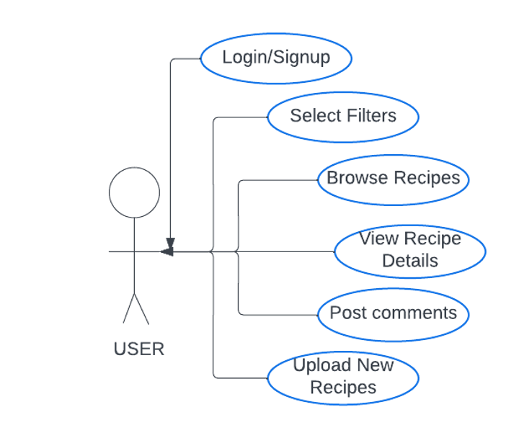
Use Case Diagram

Slide 18

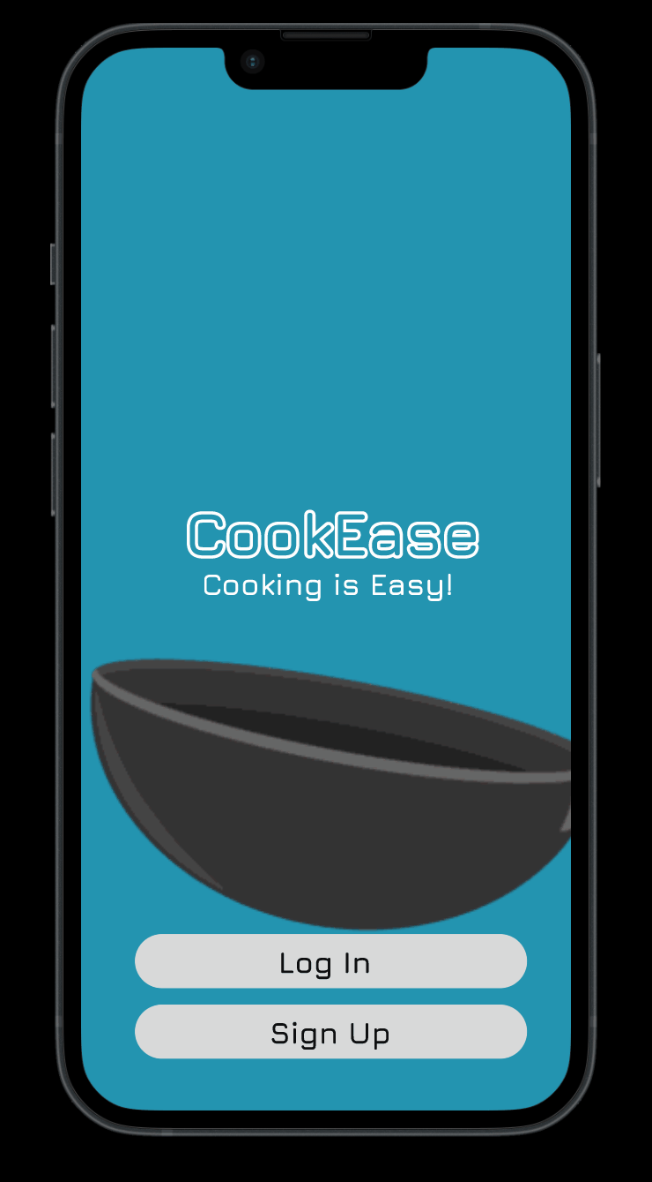
User Interface Design

Slide 19
Project Timeline
01
03
Days
Project
02
Web application
04
Hours
This project is a web application
We will have around 66 working days
Typically takes around 3 months to develop, test, and deploy
528 working hours

Slide 20
Comparison
Supercook
CookEase
Supercook.com [22] is a website that provides a recipe search engine based on ingredients that users have in their pantry.
The inputted ingredients will generate recipes and re-direct you to external recipe websites. Users may set preferences via filters.
Social media features (comments, sharing)
View recipes posted by other users
Socialize
Save recipes
Dark/Light Mode
Read aloud option
Tip option

Slide 21
Future Work/Conclusion
App Development
Localization
01
02
03
04
Enhance social features
User Feedback and Iteration
Notes:
Website Development: As a future work, we can allocate more resources and time to develop the planned website, which will provide additional functionality and accessibility to users who prefer to access recipes through a web browser.
Social Features: We can enhance the social aspect of the app by incorporating features that allow users to connect with friends, share recipes, and follow other users for updates on their latest recipes, creating a more interactive and engaging community within the app.
Localization: We can explore incorporating language translation options to accommodate non-English speakers and target a wider audience, making the app more accessible to users from different regions and cultures.
User Feedback and Iteration: Collecting feedback from users and continuously iterating on the app based on their suggestions and needs will be crucial in improving the user experience and ensuring the app remains relevant and useful in meeting the changing demands of our users.
Overall, we are excited about the future possibilities of CookEase app and look forward to further enhancing its features and functionality based on user feedback and market demand.

Slide 22
References
[1] "Buy Me a Coffee," (Buy Me a Coffee), [Online]. Available: https://www.buymeacoffee.com/ (Accessed 22 Mar 2023).
[2] "HTML & CSS Classes Cost," (NobleDesktop), [Online].
Available: https://www.nobledesktop.com/learn/html-css/cost (Accessed: 20 April 2023).
[3] R. Schulte, "Rails, Django, and Node.js: A Primer on Web Frameworks," (Medium), [Online]. Available: https://medium.com/@schulte.robert/rails-django-and-node-js-a-primer-on-web-frameworks-9c734dc1bd2c (Accessed: 20 April 2023).
[4] "MySQL Pricing," (GetApp), [Online]. Available: https://www.getapp.com/it-management-software/a/mysql/pricing/ (Accessed: 20 April 2023).
[5] "Amazon S3 Pricing," (AWS.amazon), [Online]. Available: https://aws.amazon.com/s3/pricing/ (Accessed: 20 April 2023).
[6] "Plans and Pricing," (Hasura), [Online]. Available: https://hasura.io/docs/latest/hasura-cloud/plans/ (Accessed: 20 April 2023).
[7] "Elastic Pricing FAQ," (Elastic). [Online]. Available: https://www.elastic.co/pricing/faq (Accessed: 20 April 2023).
[8] "5 Reasons YouTube Premium is Worth Every Penny," (the ascent), [Online]. Available: https://www.fool.com/the-ascent/personal-finance/articles/5-reasons-youtube-premium-is-worth-every-penny/ (Accessed: 20 April 2023).
[9] "Entry Level software engineer salary in Texas," (Indeed), [Online]. Available: https://www.indeed.com/career/entry-level-software-engineer/salaries/TX (Accessed: 20 April 2023).
[10] "Twitter's New API Access Charges Could Price Many Apps and Researchers Out of Their Projects," (SocialMediaToday), [Online]. Available: https://www.socialmediatoday.com/news/twitters-new-api-access-charges-could-price-many-apps-and-researchers-out/644775/ (Accessed: 20 April 2023).
[11] "Cookpad Terms of Service," (Cookpad), [Online]. Available: https://cookpad.com/us/terms (Accessed: 20 April 2023).
[12] "TastyIgniter Pricing, Features, Reviews and Alternatives," (GetApp), [Online]. Available: https://www.getapp.com/all-software/a/tastyigniter/ (Accessed: 20 April 2023).
[13] "Google Analytics," (Google grketing Platform), [Online]. Available: https://marketingplatform.google.com/about/analytics/ (Accessed: 20 April 2023).
[14] "Mixpanel Pricing," (Mixpanel), [Online]. Available: https://mixpanel.com/pricing/ (Accessed: 20 April 2023).
[15] "Frequently Asked Questions," (Help.BuyMeACoffee.com), [Online]. Available: https://help.buymeacoffee.com/en/articles/4539170-frequently-asked-questions (Accessed: 20 April 2023).
[16] "April 2023 Server Memory Prices," (Memory.net), [Online]. Available: https://memory.net/memory-prices/ (Accessed: 20 April 2023).
[17] "HP 15-ef2723od Laptop," (OfficeDepot), [Online]. Available: https://www.officedepot.com/a/products/1676428/HP-15-ef2723od-Laptop-156-Screen/ (Accessed: 20 April 2023).
[18] "Intel i5-13600K Desktop Processor," (Amazon), [Online]. Available: https://www.amazon.com/Intel-i5-13600K-Desktop-Processor-P-cores/dp/B0BCDR9M33/?th=1 (Accessed: 20 April 2023).
[19] "Small Business Internet," (T-Mobile), [Online]. Available: https://www.t-mobile.com/business/solutions/business-internet-services/small-business-internet?&cmpid=TFB_PG_P_TFBBIZINT_43700072663373187_651782844427&gad=1&gclid=EAIaIQobChMI2PqZvcy2_gIVjhTUAR0svwJJEAAYASAAEgJDt_D_BwE&gclsrc=aw.ds (Accessed: 20 April 2023).
[20] "Entry Level software engineer salary in Texas," (Indeed), [Online]. Available: https://www.indeed.com/career/entry-level-software-engineer/salaries/TX (Accessed: 20 April 2023).
[21] "Recipe Search API – documentation – edamam," (Edamam.com), [Online]. Available: https://developer.edamam.com/edamam-docs-recipe-api (Accessed: 13 April 2023).
[22] "Recipe search by ingredients you have at home," (SuperCook), [Online]. Available: https://www.supercook.com/#/desktop (Accessed 22 Mar 2023).

Slide 23
Thanks!

